Slide 1
Dania Beach Leadership & Career Skills University
A Path to Success for Our City’s Youth

Slide 2
Goal of DBL&CSU
Empower Dania Beach youth with opportunities to learn career skills and about local government. This will enable them to maximize their educational potential and future career prospects in life.

Slide 3
PARTNERS
Children Services Council
Broward Sheriff’s Office
Broward County State’s Attorney’s Office
Dania Beach Community Redevelopment Agency
Dania Beach Grant Advisory Board
Dania Beach Housing Authority
Department of Juvenile Justice
Broward County School Board
Department of Juvenile Justice (17th Circuit)
City of Dania Beach
Dania Beach Education Advisory Board

Slide 4
Overview of DBL&CSU
Partners have met several times, formed committees, and created a program over the past six months.
Patterned after Weston University
Students aged 16 – 18 years old from local High Schools.
8 month program for 12 – 20 students
Attend program at City Hall one day a month
Spend class time learning career skills, then have reinforced with real life seminar/training with city staff or private business presentation/assignment.
Attend & Complete one mock Commission meeting.
Seek summer employment for graduates.

Slide 5
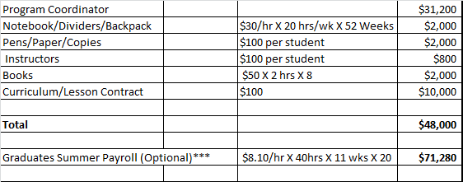
Budget & Funding
Grants:
Dept. of Justice
Department of Juvenile Justice
Health & Human Services
Dept. of Education
*Initial grant applications are for NON matching grants.
Children Services Council (Match)
Broward Sheriff’s Office (Match)
Total Costs: $119,280
Plan includes getting the summer jobs payroll paid by the employers hiring the graduates, so the total program budget is $48,000.

Slide 6
Next Steps
Approval from Dania Beach City Commission to move forward with program and Grant Application.
Approval from Broward County School Board.
Apply for federal grants
Finalize program with partners, city staff, and school board.

Slide 7
Questions?

